Slide 1
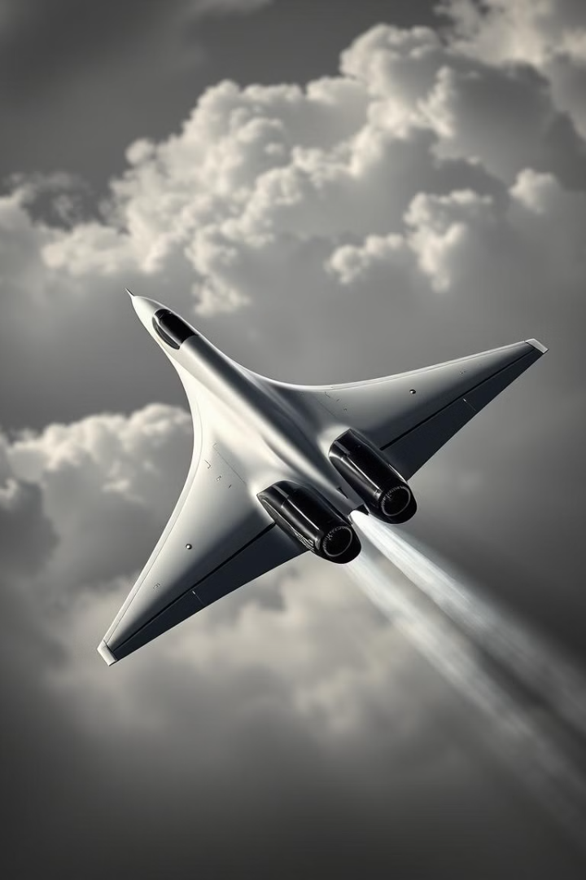

Investigation into the Concorde Crash
This presentation will delve into the tragic 2000 Air France Concorde crash, examining the events leading up to the disaster and the key factors that contributed to it.
by Presto Cranius

Slide 2
Introduction to the Concorde
Supersonic Passenger Airliner
Symbol of Luxury and Speed
Developed by France and Britain, the Concorde was capable of speeds over Mach 2.
Operated from 1976 to 2003 by Air France and British Airways, it was a symbol of luxury, speed, and engineering excellence.

Slide 3

Key Features of the Concorde
1
Powerful Engines
2
High Cruising Speed
Four Rolls-Royce/Snecma Olympus turbojet engines powered the aircraft.
Maximum cruising speed of 2,180 km/h (Mach 2.04).
3
Limited Market
Passenger capacity: 100-120 people. Extremely expensive operating costs and limited market.

Slide 4

The Fatal Flight – July 25, 2000
Air France Flight 4590
Full Fuel Load
Tragic Outcome
Departing from Paris Charles de Gaulle to New York, carrying 100 passengers and 9 crew members.
The aircraft was near full fuel capacity due to the long-haul flight.
Crashed just 46 seconds after takeoff, killing all onboard and 4 on the ground.

Slide 5
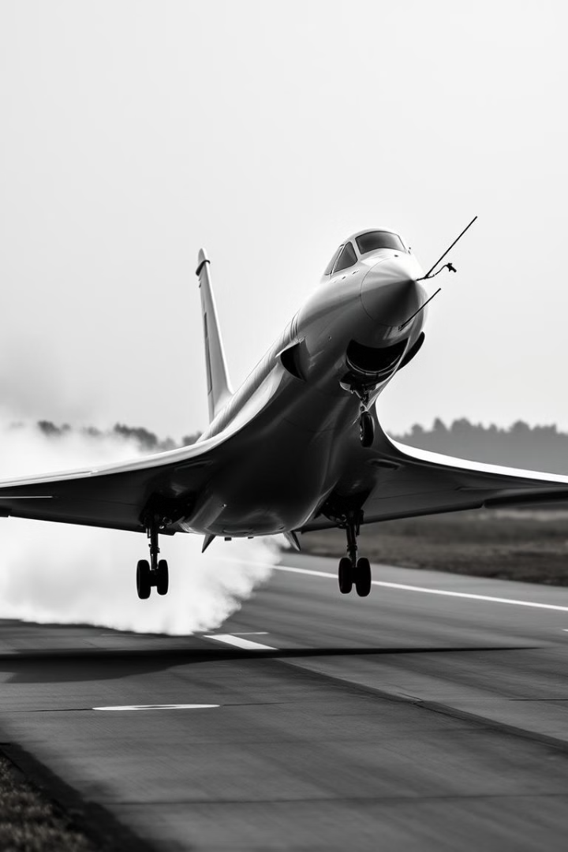



The Chain of Events Leading to the Crash
A Continental Airlines DC-10 took off minutes before the Concorde.
A metal strip (43 cm long) from the DC-10’s engine fell onto the runway.
The Concorde’s left main landing gear ran over the strip, causing a tire explosion.

Slide 6
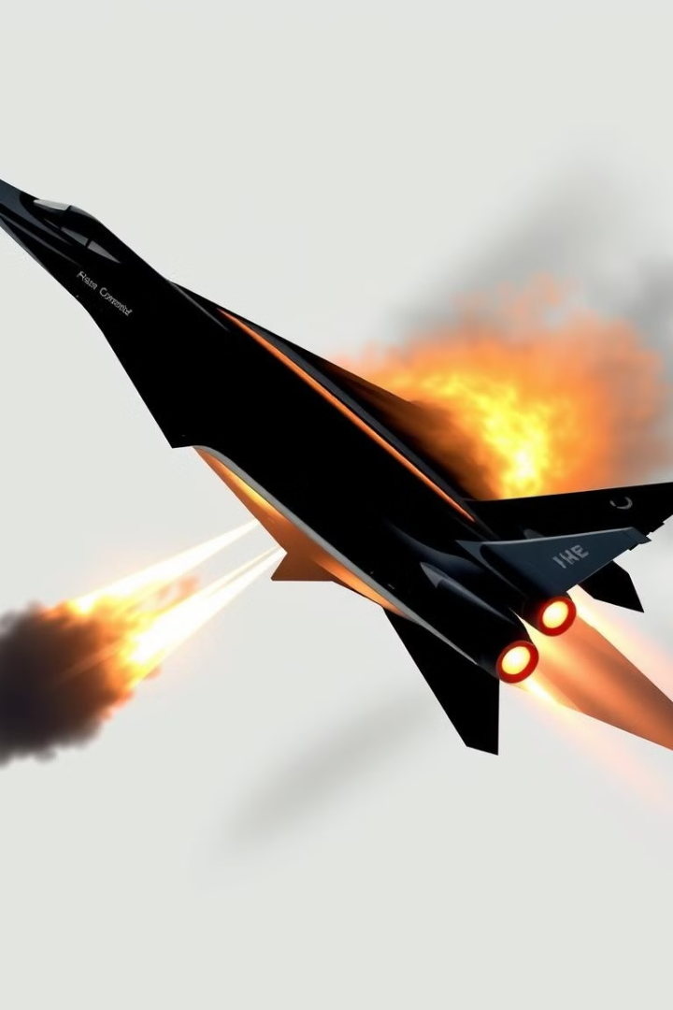
Fuel Tank Rupture and Fire
1
Tire Impact
The shockwave from the tire impact ruptured the fuel tank.
2
Fuel Leak and Ignition
Fuel leaked from the damaged tank and ignited almost immediately.
3
Possible Ignition Sources
Sparks from severed electrical wires or contact with hot engine surfaces.

Slide 7




Pilot Response and Attempts to Recover
Fire Warning
Engine Failure
Failed Recovery
The crew received a fire warning but had no option to abort takeoff.
The left engine began failing due to fire and fuel loss.
Pilots attempted to climb but struggled with asymmetric thrust. Landing gear failed to retract due to severed control wires.

Slide 8



The Final Moments
Roll Imbalance
Continued loss of thrust on left engines worsened roll imbalance.
2
Loss of Altitude
1
The aircraft reached a maximum altitude of ~200 feet.
Stalling and Crash
Pilots reduced engine power to counteract roll, causing further loss of lift. The Concorde stalled and crashed into a small hotel near the airport.
3

Slide 9



Immediate Aftermath and Rescue Efforts
Fatalities
1
All 109 onboard perished instantly, along with 4 people in the hotel.
Rescue Efforts
2
Fire engulfed the crash site, making rescue efforts impossible.
Airport Closure
3
Airport shut down operations for investigation.

Slide 10
Investigation Findings
Metal Strip Origin
1
The metal strip was traced back to the Continental Airlines DC-10.
Maintenance Issue
2
Investigation revealed improper maintenance of the DC-10 engine part.
Fuel Tank Vulnerability
3
The Concorde’s fuel tanks lacked sufficient protection from high-speed debris.

